Slide 1
Welcome
To do (HW): Add entry to food log; day 3
Please take out your food logs so I can give you 5 points for completing Tuesday’s entries.
As I do that, please take out a piece of paper and set it up so you can take Cornell-Style notes.
Your death penalty assessments are in and narratives will be in by the end of the day. Thank you for your patience!

Slide 2
Topic: Stress and Anxiety
Mrs. Weber
English 1
Essential Question: How do stress and anxiety affect our body systems and is there anything that we can do to prevent these effects?

Slide 3
Reflect
Why do people suffer from anxiety or get stressed out? Be prepared to support your claim with evidence.
Describe someone in your life that you believe is stressed. How do you know they are stressed? What signs and symptoms of stress do they exhibit? (no need to name the person)
Be Prepared to Discuss

Slide 4
5o Common signs & symptoms of stress
1. Frequent headaches, jaw clenching or pain
2. Gritting, grinding teeth
3. Stuttering or stammering
4. Tremors, trembling of lips, hands
5. Neck ache, back pain, muscle spasms
6. Light headedness, faintness, dizziness
7. Ringing, buzzing or popping sounds
8. Frequent blushing, sweating
9. Cold or sweaty hands, feet
10. Dry mouth, problems swallowing

Slide 5
50 common signs of & symptoms of stress
11. Frequent colds, infections, herpes sores
12. Rashes, itching, hives, “goose bumps”
13. Unexplained or frequent “allergy” attacks
14. Heartburn, stomach pain, nausea
15. Excess belching, flatulence
16. Constipation, diarrhea, loss of control
17. Difficulty breathing, frequent sighing
18. Sudden attacks of life threatening panic
19. Chest pain, palpitations, rapid pulse
20. Frequent urination

Slide 6
50 common signs of & symptoms of stress
21. Diminished sexual desire or performance
22. Excess anxiety, worry, guilt, nervousness
23. Increased anger, frustration, hostility
24. Depression, frequent or wild mood swings
25. Increased or decreased appetite
26. Insomnia, nightmares, disturbing dreams
27. Difficulty concentrating, racing thoughts
28. Trouble learning new information
29. Forgetfulness, disorganization, confusion
30. Difficulty in making decisions

Slide 7
50 common signs of & symptoms of stress
31. Feeling overloaded or overwhelmed
32. Frequent crying spells or suicidal thoughts
33. Feelings of loneliness or worthlessness
34. Little interest in appearance, punctuality
35. Nervous habits, fidgeting, feet tapping
36. Increased frustration, irritability, edginess
37. Overreaction to petty annoyances
38. Increased number of minor accidents
39. Obsessive or compulsive behavior
40. Reduced work efficiency or productivity

Slide 8
50 common signs of & symptoms of stress
41. Lies or excuses to cover up poor work
42. Rapid or mumbled speech
43. Excessive defensiveness or suspiciousness
44. Problems in communication, sharing
45. Social withdrawal and isolation
46. Constant tiredness, weakness, fatigue
47. Frequent use of over-the-counter drugs
48. Weight gain or loss without diet
49. Increased smoking, alcohol or drug use
50. Excessive gambling or impulse buying

Slide 9
Reflect
Do you need to exhibit all symptoms to be considered stressed? Why or why not?
In your opinion, what are the worst signs or symptoms of stress? Why? Provide evidence for your claim.
Make some predictions around what body systems you think may be affected by stress.

Slide 10
Stress & our body systems
Name that body system:
1.____________
2. ___________
3. ___________
4. ___________
5. ___________
6. ___________
7. ___________

Slide 11
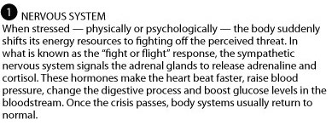
#1: Nervous system

Slide 12
#2: Musculoskeletal System

Slide 13
#3: Respiratory System

Slide 14
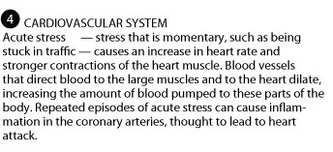
#4: Cardiovascular system

Slide 15
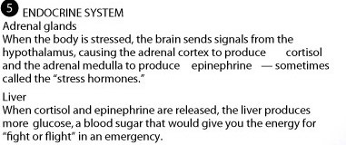
#5: Endocrine system

Slide 16
#6: Gastrointestinal System

Slide 17
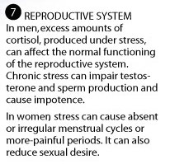
#7: Reproductive system

Slide 18
Reflect
Reread your notes on the effects of stress with your tablemates, then discuss the following questions:
In your opinion, what body system has the potential to suffer most from stress? Why?
Which effects of stress are short-term and which are long-term?

